Slide 1
P N Junction Diode

Slide 2
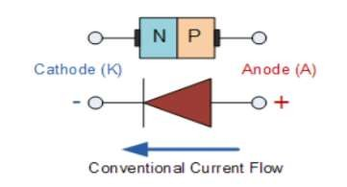
PN Junction Diode
A PN diode is formed by doping one side of intrinsic material with acceptor atoms and other side donor atoms.
P-type and N-type semiconductor material side by side on a single crystal represent PN Junction. A PN junction forms at the boundary between the two regions and a diode is created.
The p-side is considered as anode and n-side is considered as cathode.

Slide 3
PN Junction Diode
There are three possibilities in PN junction diode depending upon the application of voltage across the two terminals.
1. No Bias ( V = 0 )
2. Forward Bias ( V > 0 )
3. Reverse Bias ( V < 0 )

Slide 4
No bias mode
When diode is not connected with any bias voltage (V = 0), then it is called as no bias condition
The p region has holes as majority carriers due to the impurity atoms and only a few thermally generated free electrons as minority carriers.
The n region has free electrons as majority carriers due to the impurity atoms and only a few thermally generated holes as minority carriers.
When the junction is first formed, due to the concentration gradient, mobile charges transfer near junction.
Electrons near the junction in the n region begin to diffuse across the junction into p region where they combine with some of the holes.
Holes and Electrons recombine and uncovered the bound charges. Similarly holes leave p-type region.
This process creates uncover acceptor ion on P-side and uncover donor ions in N-side of the junction.
.

Slide 5
No bias mode
P N

Slide 6
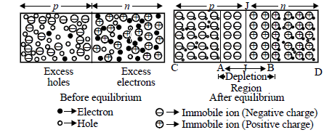
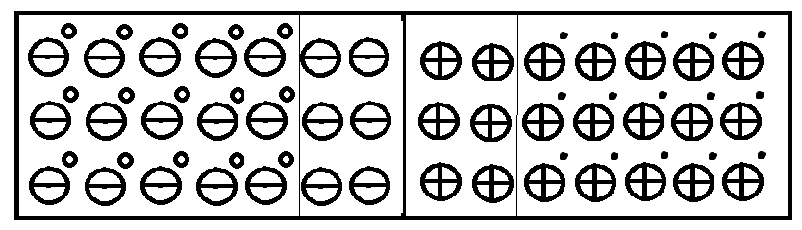

Slide 7
The n-type region close to the junction becomes depleted of electrons and positively charged, and the p-type region close to the junction becomes depleted of holes and negatively charged.
The region near to the pn-junction becomes depleted of majority carriers and is called the depletion region(Majority charge carrier empty region). The region where there is no mobile charges only bound or fixed charges are present.
The depletion region is formed very quickly and is very thin compared to the n region and p region.
A point is reached where the total negative charge in the depletion region repels any further diffusion of electrons (negatively charged particles) into the p region (like charges repel) and the diffusion stops.
In the depletion region there are many positive charges and many negative charges on opposite sides of the pn junction. So there is a force acting on the charges which form an electric field directed from n-side to p-side. The electric field is a barrier to the free electrons in the n region.
An external energy must be applied to get the electrons to move across the barrier of the electric field in the depletion region.
The potential difference of the electric field across the depletion region is the amount of voltage required to move electrons through the electric field. This potential difference is called the barrier potential

Slide 8
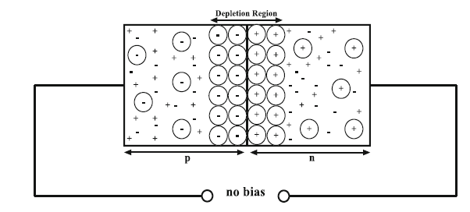
The barrier potential of a pn junction depends on several factors, including the type of semi-conductive material, the amount of doping, and the temperature.
At room temperature(25°C), the barrier potential equals approximately 0.3 V for germanium diodes and 0.6-0.7 V for silicon diodes.
The barrier potential voltage also called as knee voltage or cut-in voltage of the diode.
Barrier voltage opposes the diffusion of majority carrier across the junction where as assists drifting of minority carriers.
Under steady state
Drift current=Diffusion current
The net flow of charge in any direction for a semiconductor diode is zero, when the externally applied voltage is zero.

Slide 9
Thresh hold or Barrier voltage
Width of the Depletion region

Slide 10
No bias mode
Direction of flow of charge carrier | Type of current | Direction of current
← | electron diffusion | →
→ | hole diffusion | →
→ | electron drift | ←
← | hole drift | ←
At equlibrium the net current across the junction is zero.

